Slide 1
SYSTEM MODELLING AND DESIGN
ROAD SIGN AND ROAD STATE MOBILE NOTIFICATION APP

Slide 2
02
03
OUTLINE
01
Context diagram
Use case diagram
Class diagram
04
Sequence diagram
05
Deployment diagram

Slide 3
CONTEXT DIAGRAM
01

Slide 4
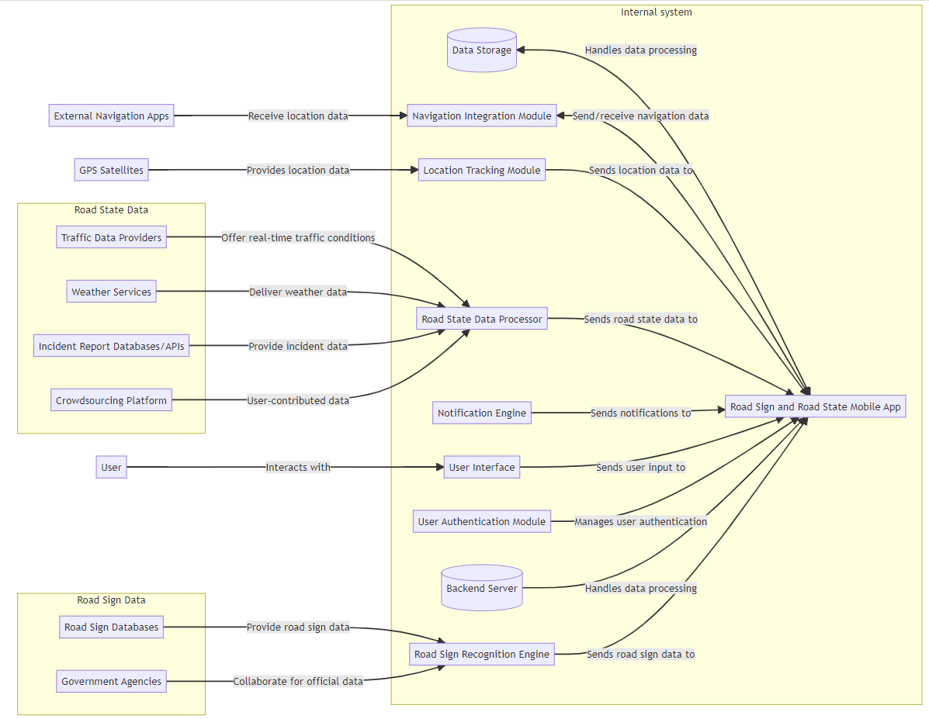
Context Diagram
Internal system
External Entities

Slide 5
Context Diagram
External Entities

Slide 6
USE CASE DIAGRAM
02

Slide 7
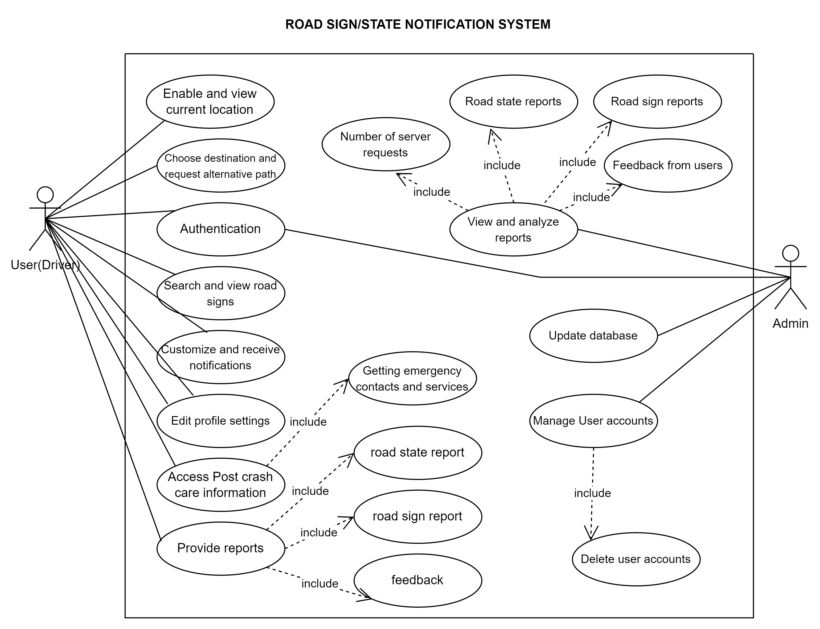
Use case Diagram

Slide 8
Use case Diagram

Slide 9
03
CLASS DIAGRAM

Slide 10
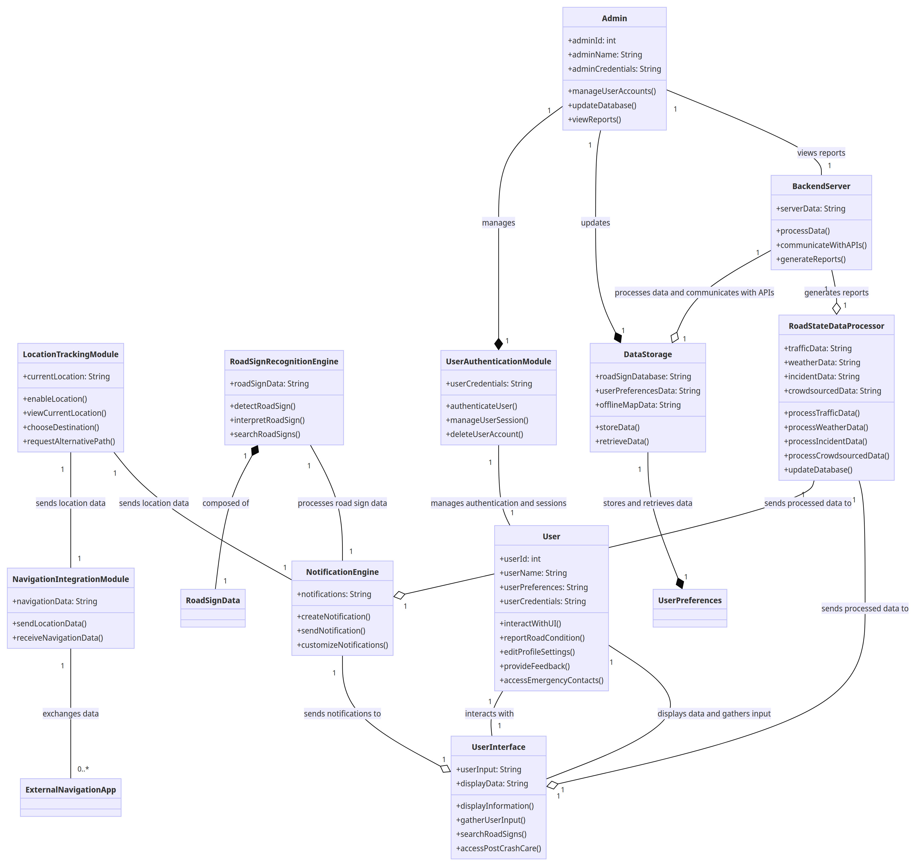

Slide 13
SEQUENCE DIAGRAM
04

Slide 14
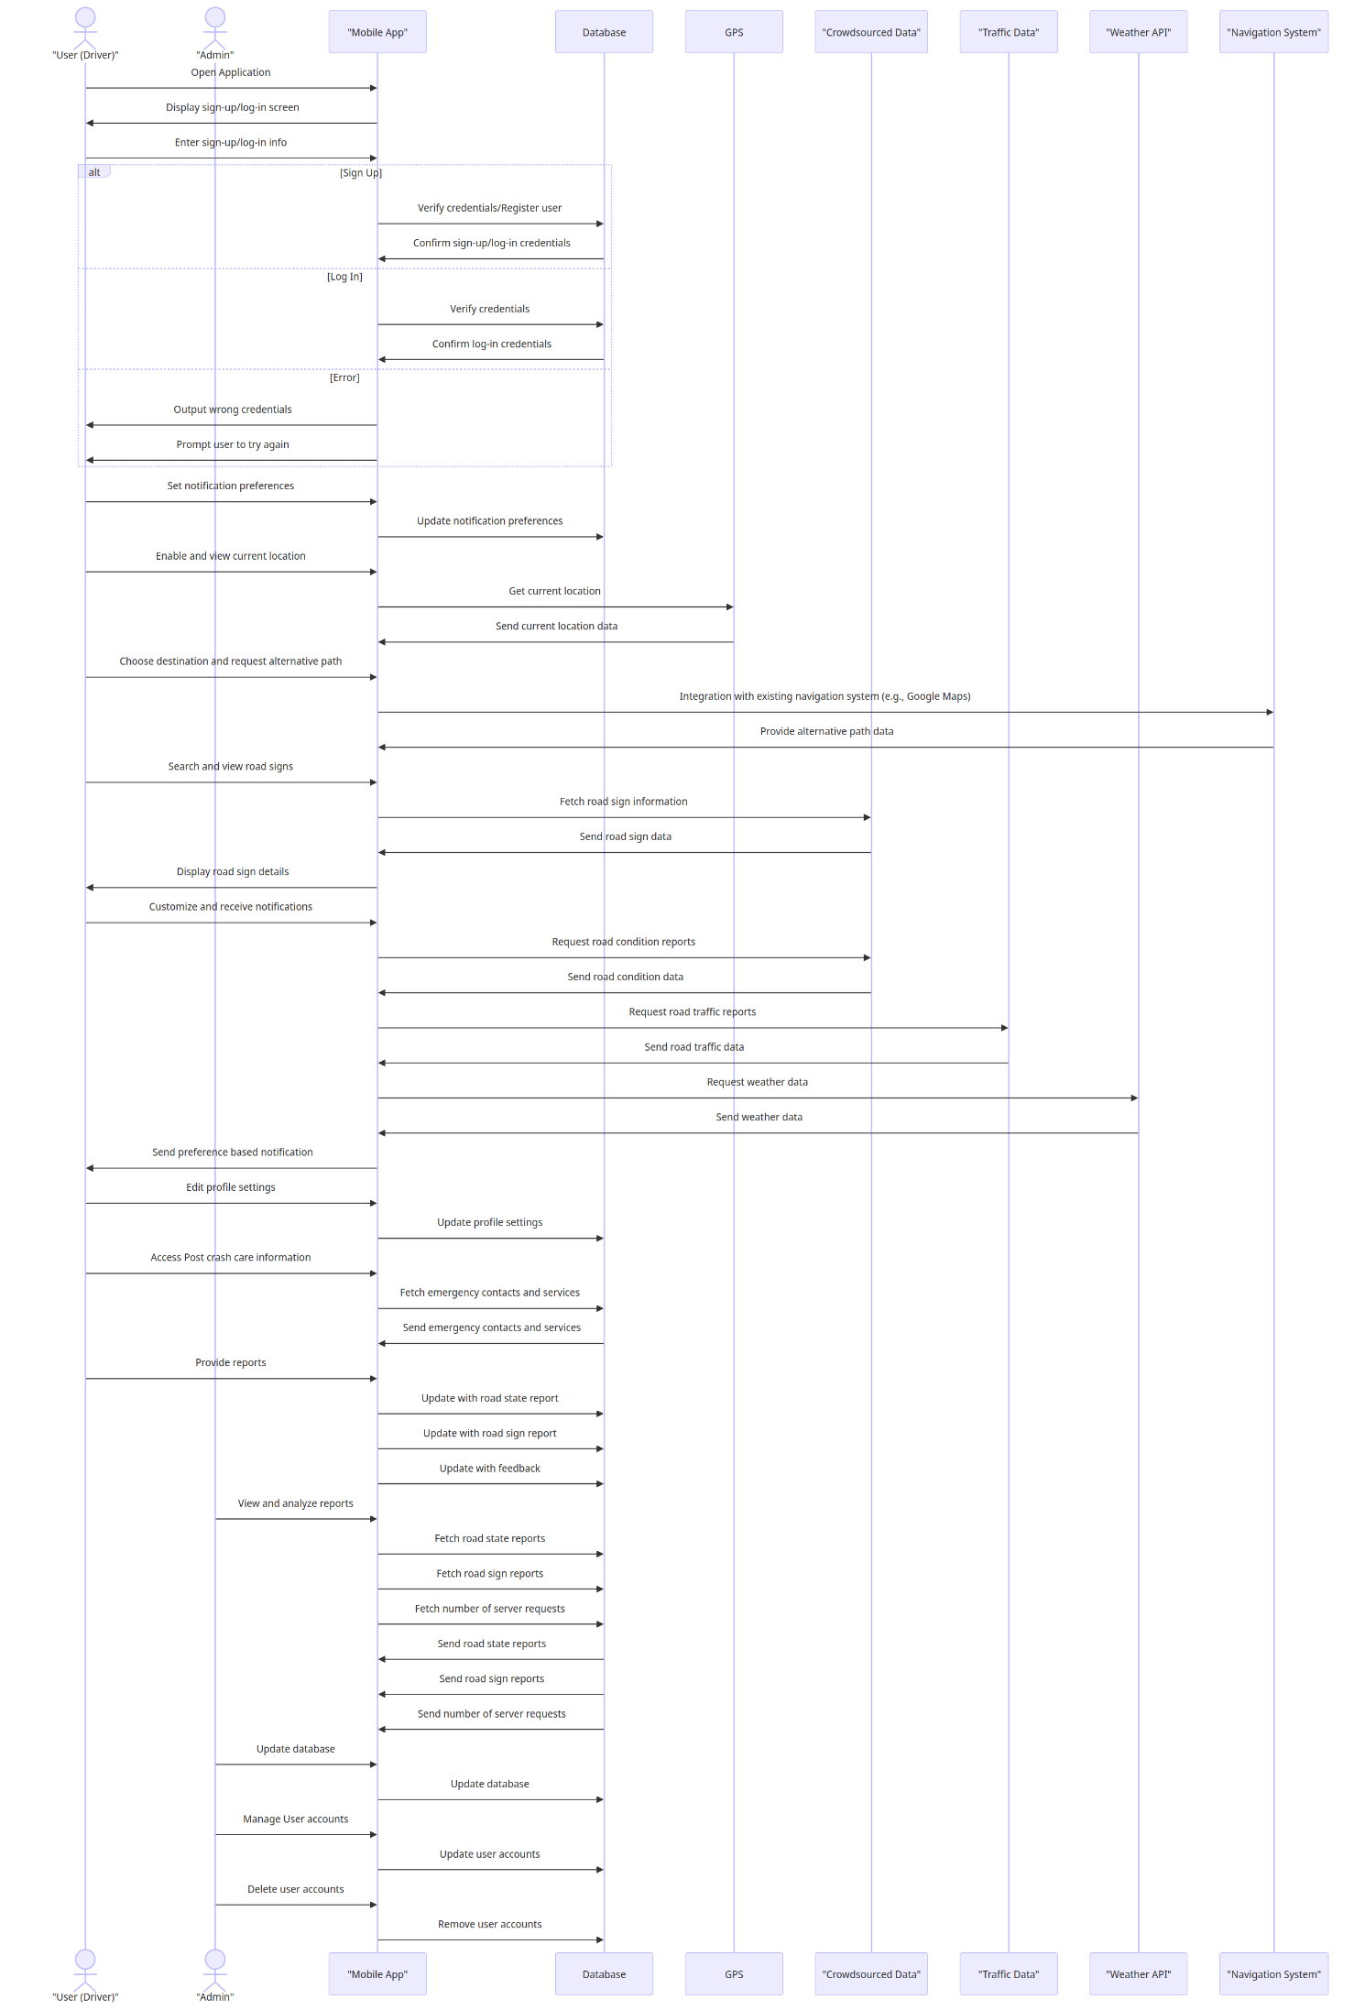
Sequence Diagram

Slide 15
Sequence Diagram

Slide 16
DEPLOYMENT DIAGRAM
05

Slide 17
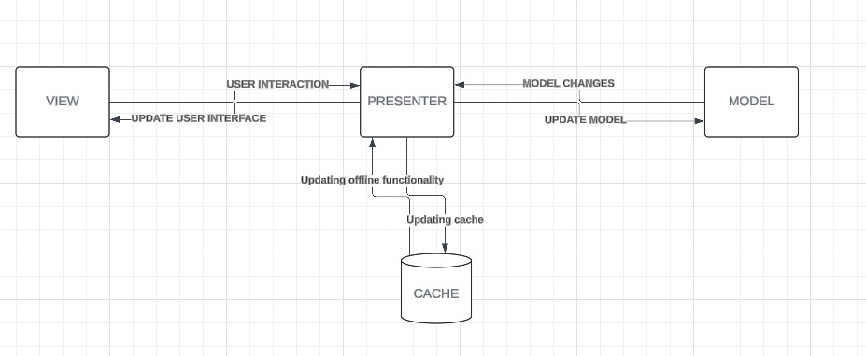
Deployment Diagram
Deployment Diagram
MVP DEPLOYMENT ABSTRACTION DIAGRAM

Slide 18
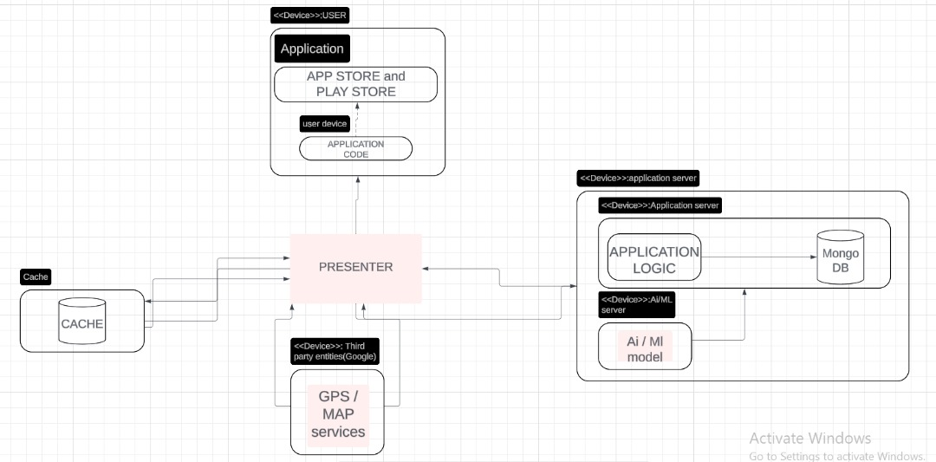
Deployment Diagram
DETAILED DEPLOYMENT DIAGRAM

Slide 19
THANK YOU
PRESENTED BY GROUP 3

